Slide 1
NLP-AI
Java Lecture No. 15
Satish Dethe
satishd@cse.iitb.ac.in

Slide 2
Contents
String Distance
String Comparison
Need in Spell Checker
Levenshtein Technique
Swapping
nlp-ai@cse.iitb

Slide 3
String Comparison
Accuracy measurement: compare the transcribed and intended strings and identify the errors
Automated error tabulation: a tricky task.
Consider the following example:
transformation (intended text)
transxformaion (transcribed text)
A simple characterwise comparison gives 6 errors. But there are only 2: insertion of ‘x’ and omission of ‘t’.
nlp-ai@cse.iitb

Slide 4
Need in Spell Checker
The difference between two strings is an important parameter for suggesting alternatives for typographical errors
Example:
difference (“game”, “game”); //should be 0
difference (“game”, “gme”); //should be 1
difference (“game”, “agme”); //should be 2
Possible ways for correction (for last example):
1. delete ‘a’, insert ‘a’ after ‘g’
2. insert ‘g’ before ‘a’, delete the succeeding ‘g’
3. substitute ‘g’ for ‘a’, substitute ‘a’ for ‘g’
If search in vocabulary is unsuccessful, suggest alternatives
Words are arranged in ascending order by the string distance and then offered as suggestions (with constraints)
nlp-ai@cse.iitb

Slide 5
String Distance
Definition: String distance between two strings, s1 and s2, is defined as the minimum number of point mutations required to change s1 into s2, where a point mutation is one of substitution, insertion, deletion
Widely used methods to find out string distance:
    Hamming String Distance: For strings of equal length
    Levenshtein String Distance: For strings of unequal length
nlp-ai@cse.iitb
Notes:
Active voice

Slide 6
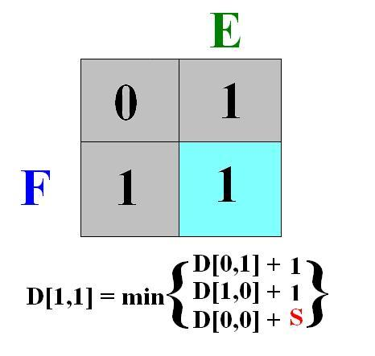
Levenshtein Technique

Slide 7
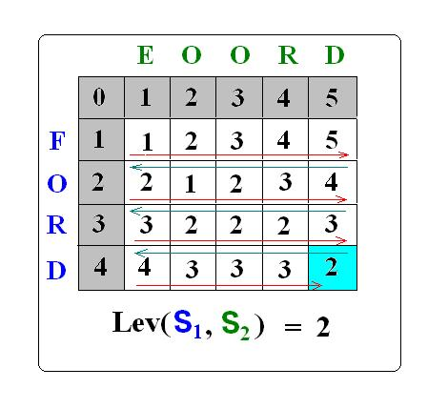
Levenshtein Technique
nlp-ai@cse.iitb

Slide 8
Levenshtein String Distance: Implementation
int equal (char x,char y){
if(x = = y ) return 0; // equal operator
else return 1;
}
int Lev (string s1, string s2){
for (i=0;i<=s1.length();i++) D[i,0] = i; // Initializing first column
for (i=0;i<=s2.length();i++) D[0,i] = i; // Initializing first row
for (i=1;i<=s1.length();i++){
for (j=1;j<=s2.length();i++){
D[i,j]=min(D[i-1,j]+1,
D[i,j-1]+1,
equal (s1[i] , s2[j]) + D[i-1,j-1] );
} }}

Slide 9
Levenshtein String Distance: Applications
Spell checking
Speech recognition
DNA analysis
Plagiarism detection

Slide 10
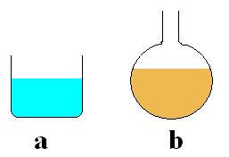
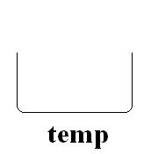
Swapping
Swapping is an important technique in most of the sorting algorithms.
int a = 242, b = 215, temp;
temp = a; // temp = 242
a = b; // a = 215
b = temp; // b = 242
swap.java
nlp-ai@cse.iitb

Slide 11
Bubble Sort
Initial elements : 4 2 5 1 9 3 8 7 6
iteration : [1] 4 2 5 1 9 3 8 7 6
2 4 5 1 9 3 8 7 6
[2] 2 4 5 1 9 3 8 7 6
[3] 2 4 5 1 9 3 8 7 6
2 4 1 5 9 3 8 7 6
[4] 2 4 1 5 9 3 8 7 6
[5] 2 4 1 5 9 3 8 7 6
2 4 1 5 3 9 8 7 6

Slide 12
Assignments
Swap two integers without using an extra variable
Swap two strings without using an extra variable
nlp-ai@cse.iitb

Slide 13
References
http://www.merriampark.com/ld.htm
http://www.yorku.ca/mack/CHI01a.htm
http://www.csse.monash.edu.au/~lloyd/tildeAlgDS/Dynamic/edit
nlp-ai@cse.iitb

Slide 14
End
Thank You!
Wish You a Very Happy New Year..
Yahoo!
nlp-ai@cse.iitb

